Slide 1
Microeconomics for Business
Demand (material from ch 4 and ch 5)

Slide 2
69 Cent Gas
What is your response?

Slide 3

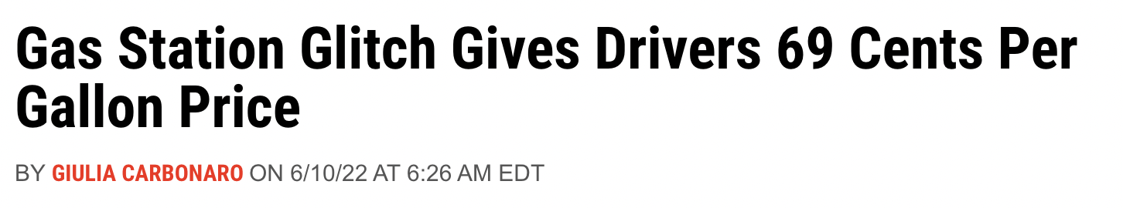
When the price isn’t right?
"I filled my car up left, came back with a second car, filled it up, then left again and came back with my cousin and filled up 150 gallons of a 500 gallon tank," Surita told Newsweek.
"The whole gas station was filled with cars and people with extra gas cans," he added.

Slide 4

Value?

Slide 5
Stickers
PRICE | QUANTITY PURCHASED
$
1

Slide 6
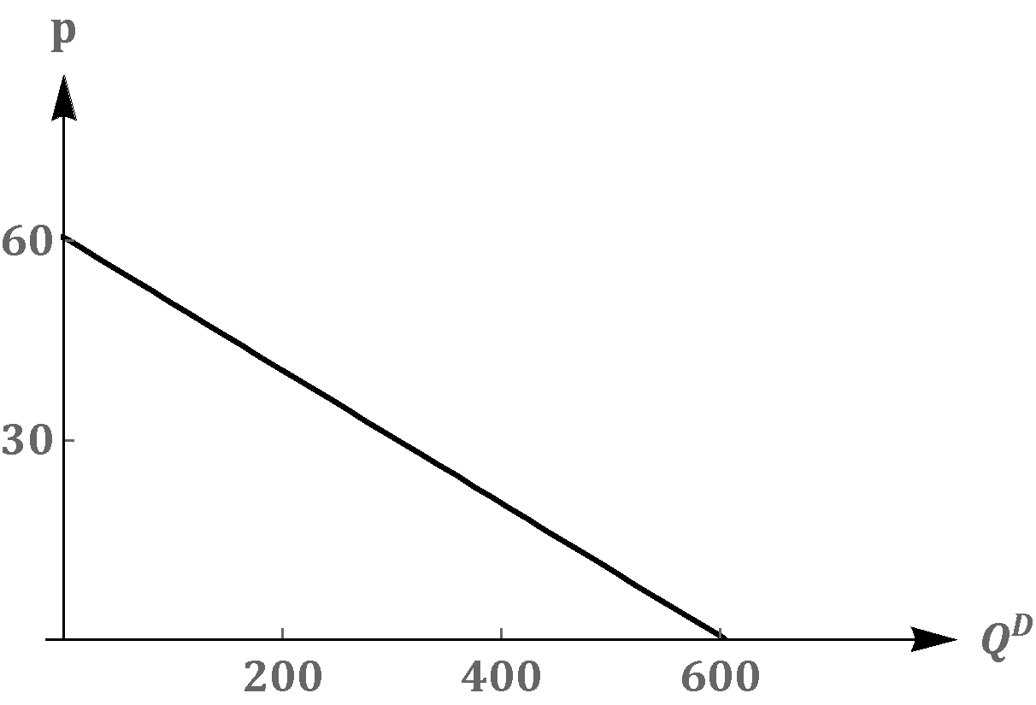
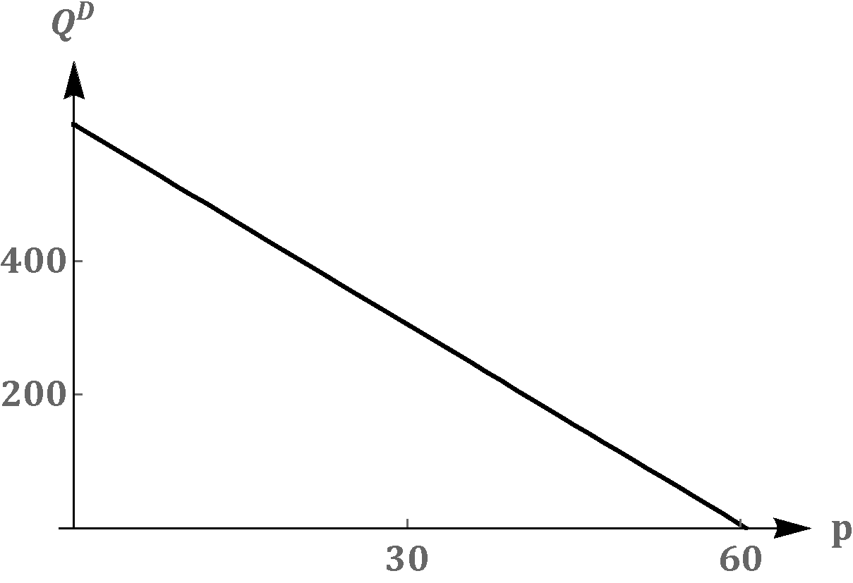


Market Demand and Inverse Demand: Illustration
Demand
Inverse Demand

Slide 7
Where does the curve come from?

Slide 8
Where does the curve come from?
# of buyers
Preferences
  Tastes
  Income
  Expectations
Other Prices (related goods)

Slide 9
Stated vs. Revealed Preference
Revealed preference is an important idea in economics. People may state that the prefer one thing but their actions differ (their revealed preference).

Slide 10
Stated vs. Revealed Preference (examples)
Stated love for the environment vs. consumption decisions
Watch Later vs. What you actually watch
Gym membership vs. Gym attendance
Stated voting vs. Voting with your feet
Revealed preference important in product development, you want to make something people will buy vs. what they say they’ll buy (consumers often don’t know what they want)

Slide 11
Stated vs. Revealed Preference (examples)
In economics empirical work we use purchase decisions, so we work with revealed preference not stated preference.
Example of revealed preference differing from stated preference, i.e. actions over words?

Slide 12
Where does the curve come from?
# of buyers
Preferences
  Tastes
  Income
  Expectations
Other Prices

Slide 13
Demand Curve Shifters
The demand curve shows how price affects quantity demanded, other things being equal. (ceteris paribus)
If the other things change (# of buyers, preferences, other prices), then the D curve moves
Notes:
‹#›

Slide 14
Demand Curve Shifters: # of Buyers
Increase in # of buyers
increases quantity demanded at each price, shifts D curve to the right.
Notes:
‹#›

Slide 15
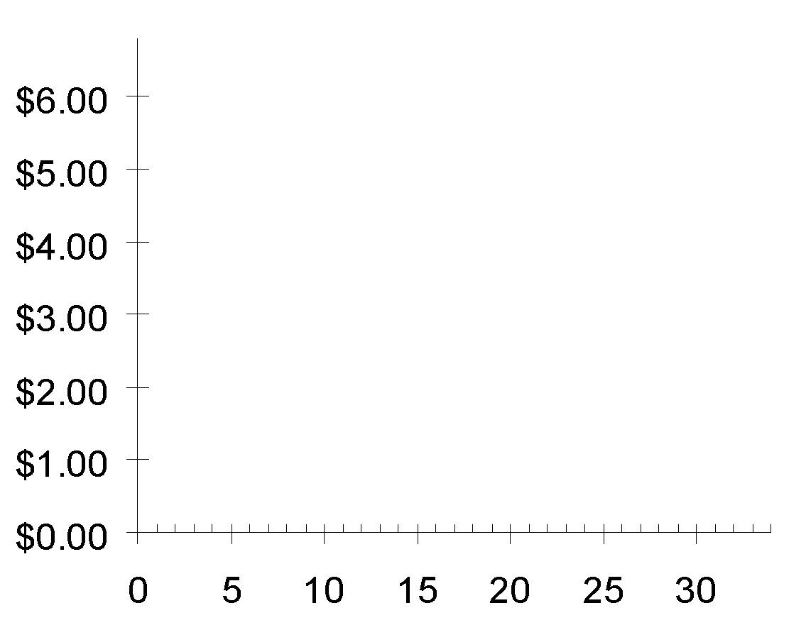
Demand Curve Shifters: # of Buyers
P
Suppose the number of buyers increases.
Then, at each P,
Q^{d} will increase
(by 5 in this example).
Q
Notes:
‹#›

Slide 16
Demand Curve Shifters: Income
Demand for a normal good is positively related to income.
  Increase in income causes
  increase in quantity demanded at each price, shifts D curve to the right.
(Demand for an inferior good is negatively related to income. An increase in income shifts D curves for inferior goods to the left.)
Notes:
‹#›

Slide 17
Demand Curve Shifters: Prices of Related Goods
Two goods are substitutes if
an increase in the price of one
causes an increase in demand for the other.
Example: pizza and hamburgers.
An increase in the price of pizza
increases demand for hamburgers,
shifting hamburger demand curve to the right.
Other examples: Coke and Pepsi,
Ketchup and Sriracha
Notes:
‹#›
If you are willing to spend a couple extra minutes on substitutes and complements, and have a blackboard or whiteboard to draw on, here’s an idea:
Before (or instead of) showing this slide, draw the demand curve for hamburgers. Pick a price, say $5, and draw a horizontal line at that price, extending from the vertical axis through the D curve and continuing to the right. Suppose Q = 1000 when P = $5. Label this on the horizontal axis.
Now ask your students: If pizza becomes more expensive, but price of hamburgers does not change, what would happen to the quantity of hamburgers demanded? Would it remain at 1000, would it increase, or would it decrease? Explain.
Some and perhaps most students will see right away that people will want more hamburgers when the price of pizza rises. After establishing this, note that the increase in the price of pizza caused an increase in the quantity demanded of hamburgers. Then state the term “substitutes” and give the definition.
Before giving the other examples (listed in the 3rd bullet of this slide), do a similar exercise to develop the concept of complements. Finally, give the examples of substitutes and complements from the 3rd bullet point of this and the following slides, but mix up the order and ask students to identify whether each example is complements or substitutes.

Slide 18
Demand Curve Shifters: Prices of Related Goods
Two goods are complements if
an increase in the price of one
causes a fall in demand for the other.
Example: computers and software.
If price of computers rises,
people buy fewer computers,
and therefore less software.
Software demand curve shifts left.
Other examples: college tuition and textbooks,
bagels and cream cheese, eggs and bacon
Notes:
‹#›

Slide 19
Demand Curve Shifters: Tastes
Anything that causes a shift in tastes toward a good will increase demand for that good
and shift its D curve to the right.
Example:
The Atkins diet became popular in the ’00s,
caused an increase in demand for eggs,
shifted the egg demand curve to the right.
Notes:
‹#›

Slide 20
Demand Curve Shifters: Expectations
If you expect a good to go up or down in price in the future, that will shift demand today
Example:
I think a price hike is coming to lego sets,
shifting my current lego demand curve to the right.
Notes:
‹#›

Slide 21
Changes in Equilibrium (Demand)
Demand Shifters
T astes
R elated goods
I ncome
B uyers
E xpectations
IMPORTANT NOTE:
Price changes move us along existing demand curve

Slide 22

Changes in Equilibrium (Demand)
https://practice.mru.org/demand/

Slide 23

Where do preferences come from?
i.e. Why do people like what they like?
Rene Girard and Mimetic desire
"Man is the creature who does not know what to desire, and he turns to others in order to make up his mind. We desire what others desire because we imitate their desires."
Like a child who wants a toy only when he sees another child playing with it
The theory of mimetic desire has become increasingly popular to explain human behavior in the age of social media (e.g. TikTok made me buy it)

Slide 24
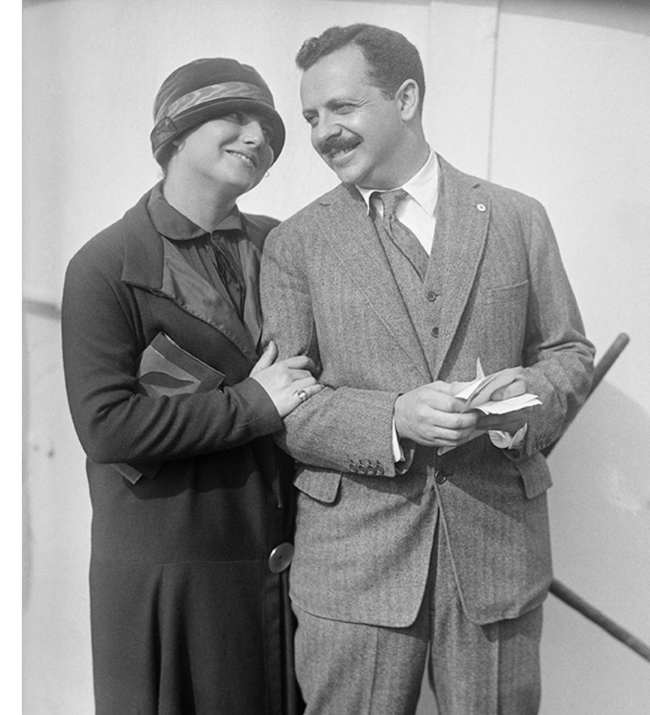
Mimetic Desire Example
Edward Bernays (father of PR) hired by Lucky Strike Cigarettes to get women to smoke
Prior to Bernays, smoking for women seen as low class/for prostitutes

Slide 25
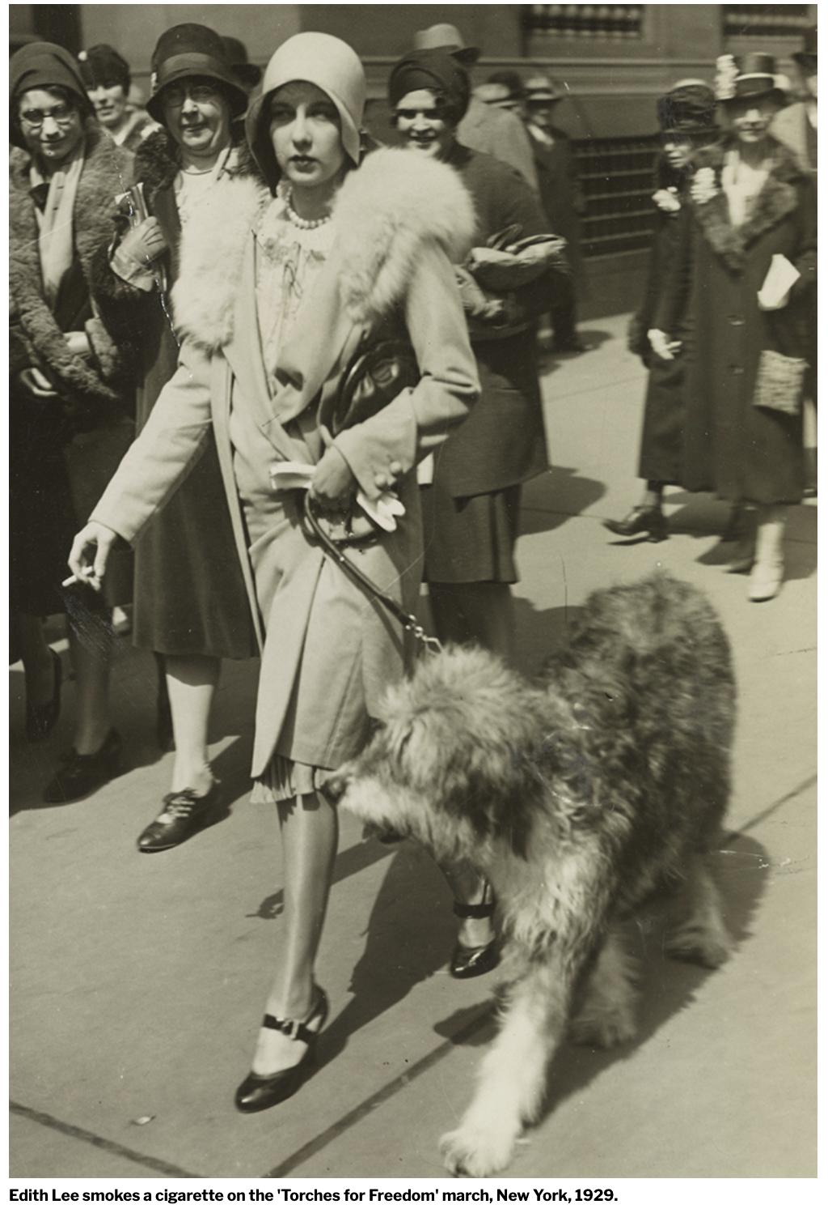
Mimetic Desire Example
Bernays hires 11 women to light up at a large Easter parade in 1929 and alerts the press
When interviewed, Bernays instructs women to frame smoking as act of liberation. “Torches of Freedom”
‘In the interests of equality of the sexes and to fight another sex taboo I and other young women will light another torch of freedom by smoking cigarettes while strolling on Fifth Avenue Easter Sunday.’ - telegram sent to press from Bertha Hunt (Bernays’ secretary)
Bertha Hunt says ‘she first got the idea for this campaign when a man with her in the street asked her to extinguish her cigaret [sic] as it embarrassed him. “I talked it over with my friends, and we decided it was high time something was done about the situation”

Slide 26
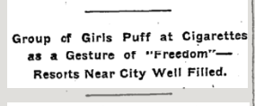

Mimetic Desire Example
New York Times takes the bait – writes an article (connection to Bernays and American Tobacco are never revealed)
Event is covered in many other US newspapers, reporting the story of the young women and their ‘torches of freedom’.

Slide 27
More on Preferences
JP Morgan: “A (person) always has two reasons for doing anything: a good reason and the real reason”
Negative views: envy + moral justification
Positive views: self interest + moral justification

Slide 28
Demand Curve
What is it?
Where does it come from?

Slide 29
Supply

Slide 30
Supply
The quantity supplied of any good is the amount that sellers are willing and able to sell.
Law of supply: the claim that the quantity supplied of a good rises when the price of the good rises, other things equal
Notes:
‹#›
Supply comes from the behavior of sellers.

Slide 31
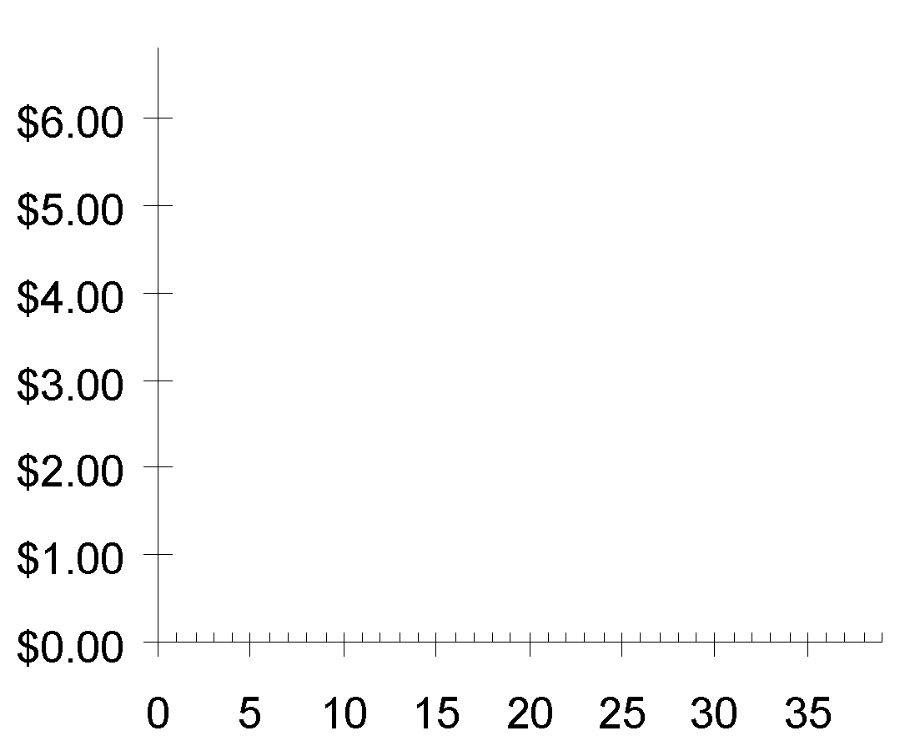
The Market Supply Curve
P
P | Q^{S} (Market)
$0.00 | 0
1.00 | 5
2.00 | 10
3.00 | 15
4.00 | 20
5.00 | 25
6.00 | 30
Q
Notes:
‹#›

Slide 32
Why does supply slope upward?
Higher prices allow high cost suppliers to make a profit, they therefore start operations, overall increasing the quantity supplied
Existing suppliers expand capacity when prices increase
Notes:
‹#›
Supply comes from the behavior of sellers.

Slide 33
Theory vs. the Real World
We will cover how firms affect prices in the real world, for now we are assuming perfect competition (where firms cannot set prices)
Notes:
‹#›
Supply comes from the behavior of sellers.

Slide 34
Cost and the Supply Curve
Cost is the value of everything a seller must give up to produce a good (including opportunity cost).
Cost of all resources used to produce good, including value of the seller’s time.
Example: Costs of 3 sellers in the lawn-cutting business.
name | cost
Jack | $10
Janet | 20
Chrissy | 35
A seller will produce and sell the good/service only if the price exceeds his or her cost.
Hence, cost is a measure of willingness to sell.
Notes:
‹#›
The material on cost, producer surplus, and the supply curve is analogous to the material earlier on WTP, consumer surplus, and the demand curve. Therefore, this section provides a bit less detail and should move a little more quickly.

Slide 35
Supply Curve Shifters
The supply curve shows how price affects quantity supplied, other things being equal.
These “other things” are non-price determinants of supply.
Changes in them shift the S curve…
Notes:
‹#›
“Non-price determinants of supply” simply means the things—other than the price of a good—that determine sellers’ supply of the good.

Slide 36
Supply Curve Shifters: Input Prices
Examples of input prices:
wages, prices of raw materials.
A fall in input prices makes production
more profitable at each output price,
so firms supply a larger quantity at each price,
and the S curve shifts to the right.
Notes:
‹#›
In the second bullet point, “output price” just means the price of the good that firms are producing and selling. I have used “output price” here to distinguish it from “input prices.”

Slide 37
Supply Curve Shifters: Input Prices
P
Suppose the price of milk falls.
At each price, the quantity of
lattes supplied
will increase
(by 5 in this example).
Q
Notes:
‹#›
Again, the animation here is carefully designed to help make clear that a shift in the supply curve means that there is a change in the quantity supplied at each possible price. If it seems tedious, you can turn it off.
In any case, be assured that, by the end of this chapter, the animation of curve shifts will be streamlined and simplified.

Slide 38
Supply Curve Shifters: Technology
Technology determines how much inputs are required to produce a unit of output.
A cost-saving technological improvement has
the same effect as a fall in input prices,
shifts S curve to the right.
Notes:
‹#›

Slide 39
Supply Curve Shifters: # of Sellers
An increase in the number of sellers increases the quantity supplied at each price,
shifts S curve to the right.
Notes:
‹#›

Slide 40
Supply Curve Shifters: Expectations
If producers expect a change in the price in the future, that will shift the current supply curve.
Example:
I expect surfboard prices to increase in the summer, so I won’t list my used surfboard on OfferUp today
Notes:
‹#›

Slide 41
Summary: Variables that Influence Sellers
Change in this variable–
Price …causes a movement
along the S curve
Input Prices …shifts the S curve
Technology …shifts the S curve
# of Sellers …shifts the S curve
Expectations … shifts the S curve
Notes:
‹#›

Slide 42
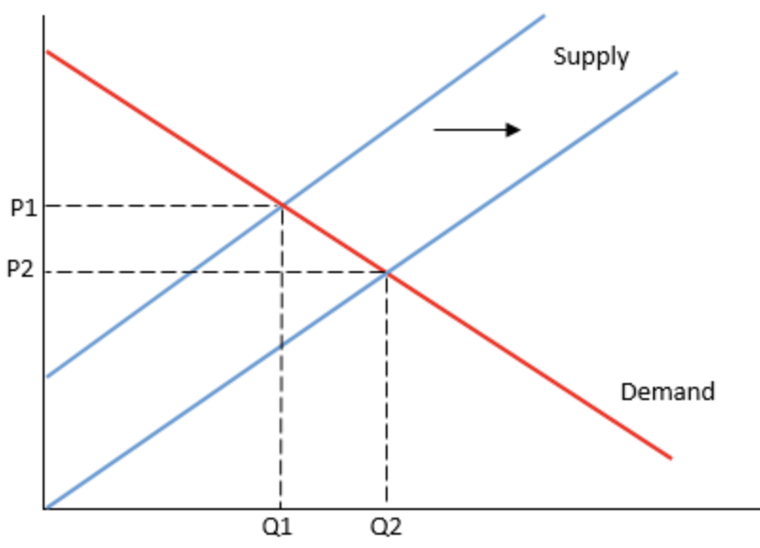
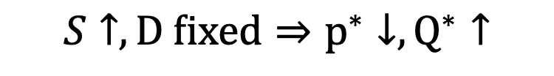
Supply Changes
Increase in Supply
Notes:
‹#›
Supply comes from the behavior of sellers.

Slide 43
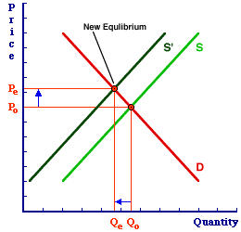
Supply Changes
Decrease in Supply
S down, D fixed -> P , Q
Notes:
‹#›
Supply comes from the behavior of sellers.

Slide 44

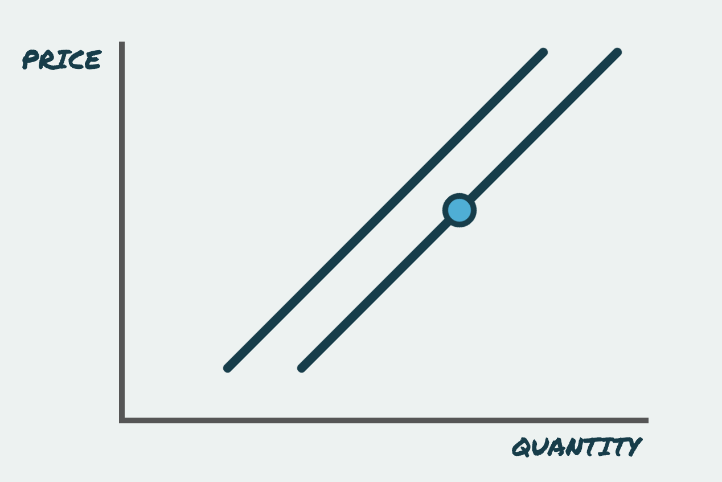
Changes in Supply
https://practice.mru.org/supply/

